Slide 1

Customer Shopping Behavior Analysis
Analyzing 3,900 purchases to understand spending patterns, segment customers, and optimize strategies.

Slide 2

Project Overview
Identify Patterns
Uncover customer spending habits.
Segment Customers
Group based on behavior and preferences.
Subscription Impact
Evaluate how subscription status affects purchases.
Data-Driven Strategy
Support business decisions with insights.

Slide 3
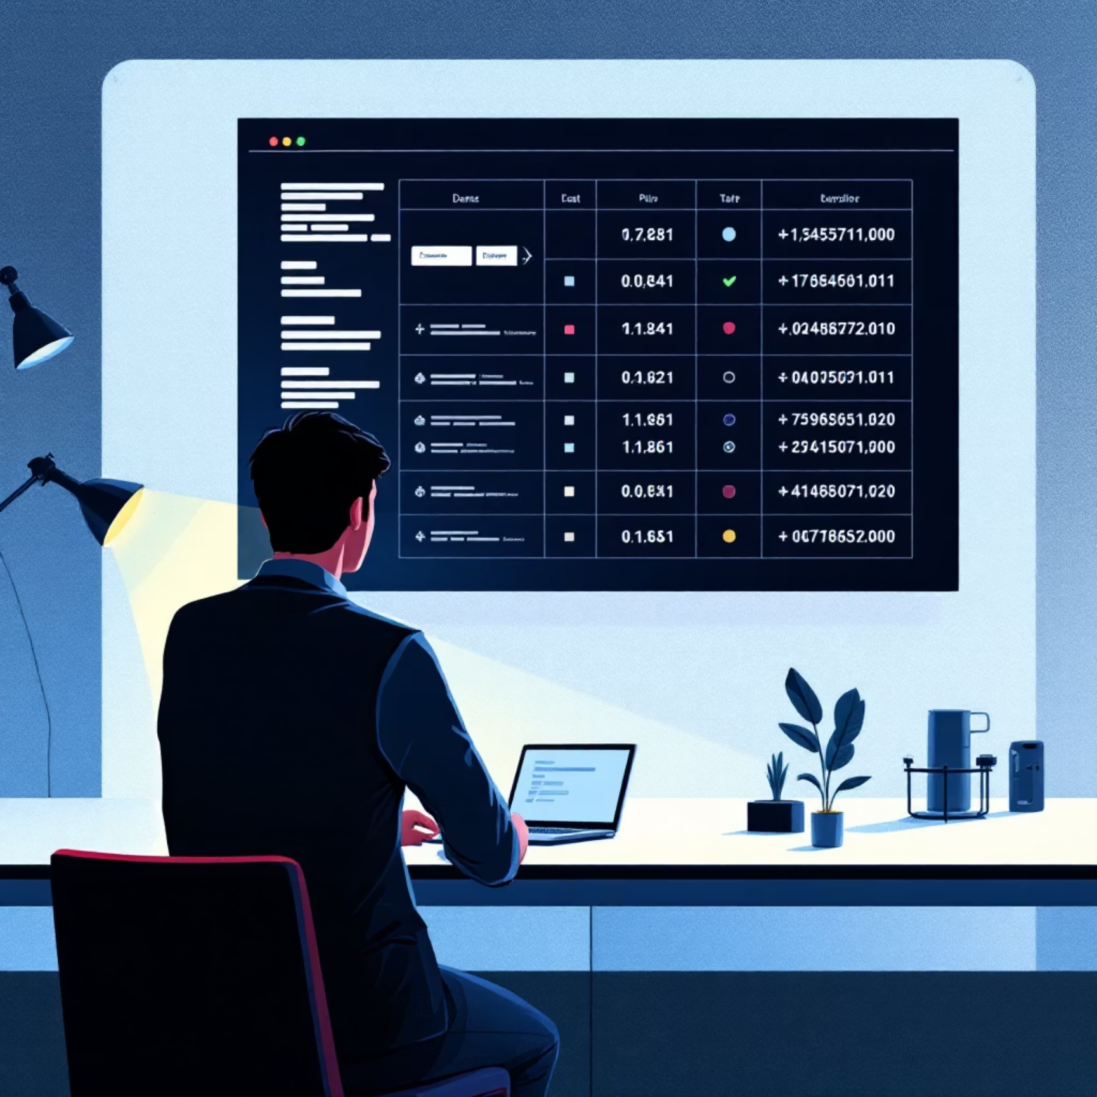
Dataset Summary
Data Points
Data Quality
3,900 records, 18 features.
37 missing values in Review Rating.
Demographics: Age, Gender, Location, Subscription.
All other features complete.
Purchase: Item, Category, Amount, Season, Size, Color.
Behavior: Discount, Promo, Previous Purchases, Frequency, Review, Shipping.

Slide 4
Exploratory Data Analysis (Python)
01
02
03
Data Loading & Exploration
Missing Data Handling
Column Standardization
Pandas for import, df.info() and .describe() for overview.
Imputed Review Rating with median per category.
Renamed columns to snake_case.
04
05
Feature Engineering
Database Integration
Created age_group and purchase_frequency_days.
Loaded cleaned data into PostgreSQL.

Slide 5

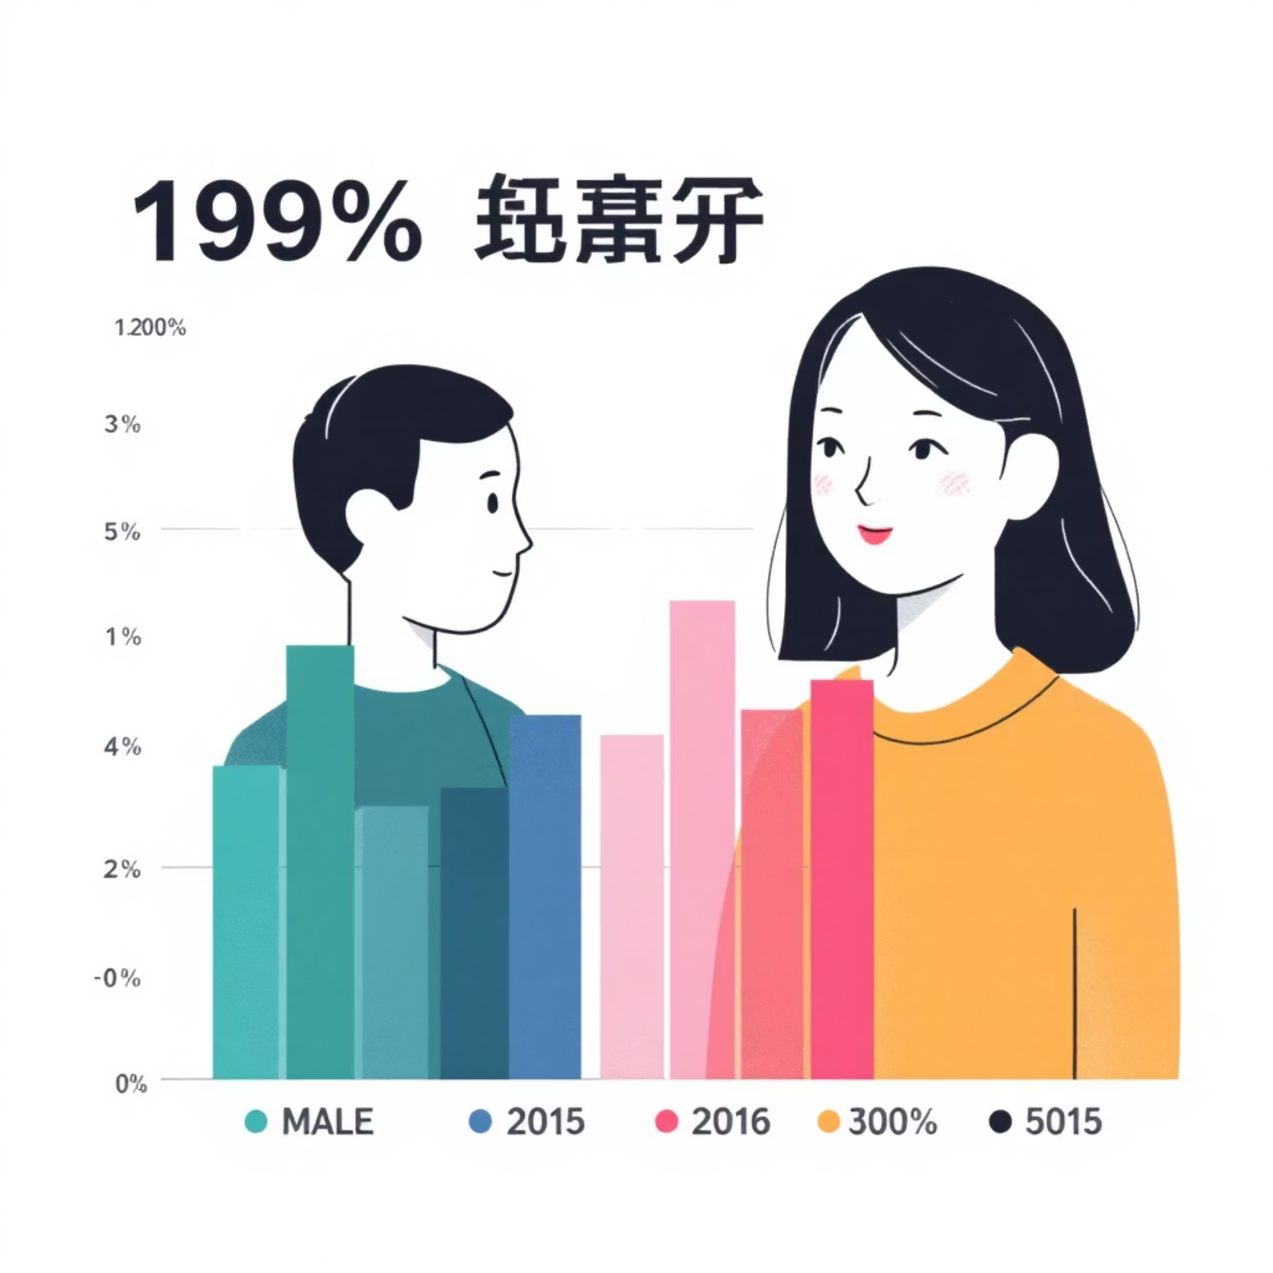
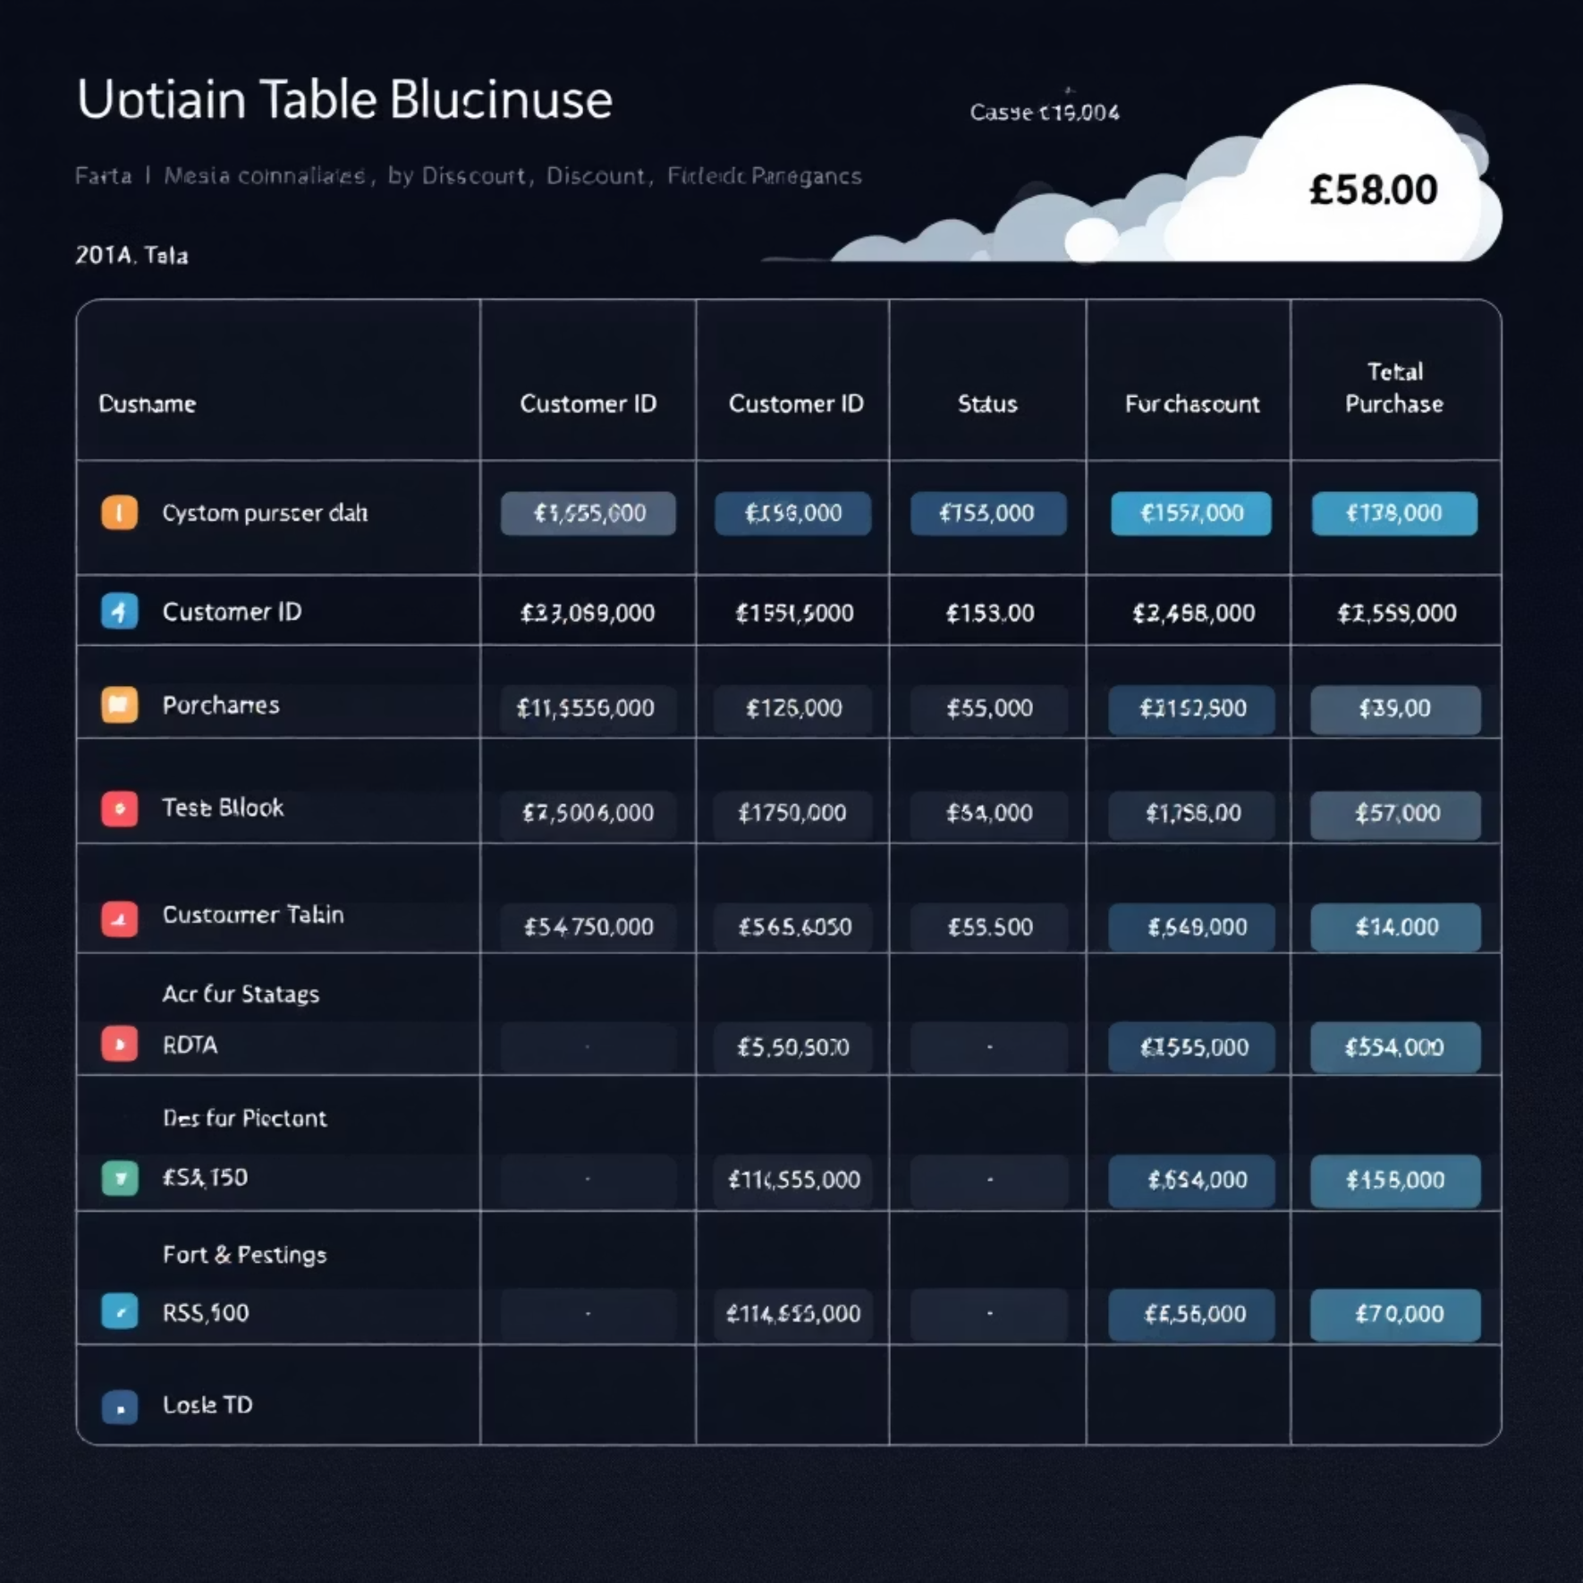
SQL Analysis: Revenue & Discounts
Revenue by Gender
Discount Usage
Total revenue from male vs. female customers.
Customers using discounts but spending above average.

Slide 6
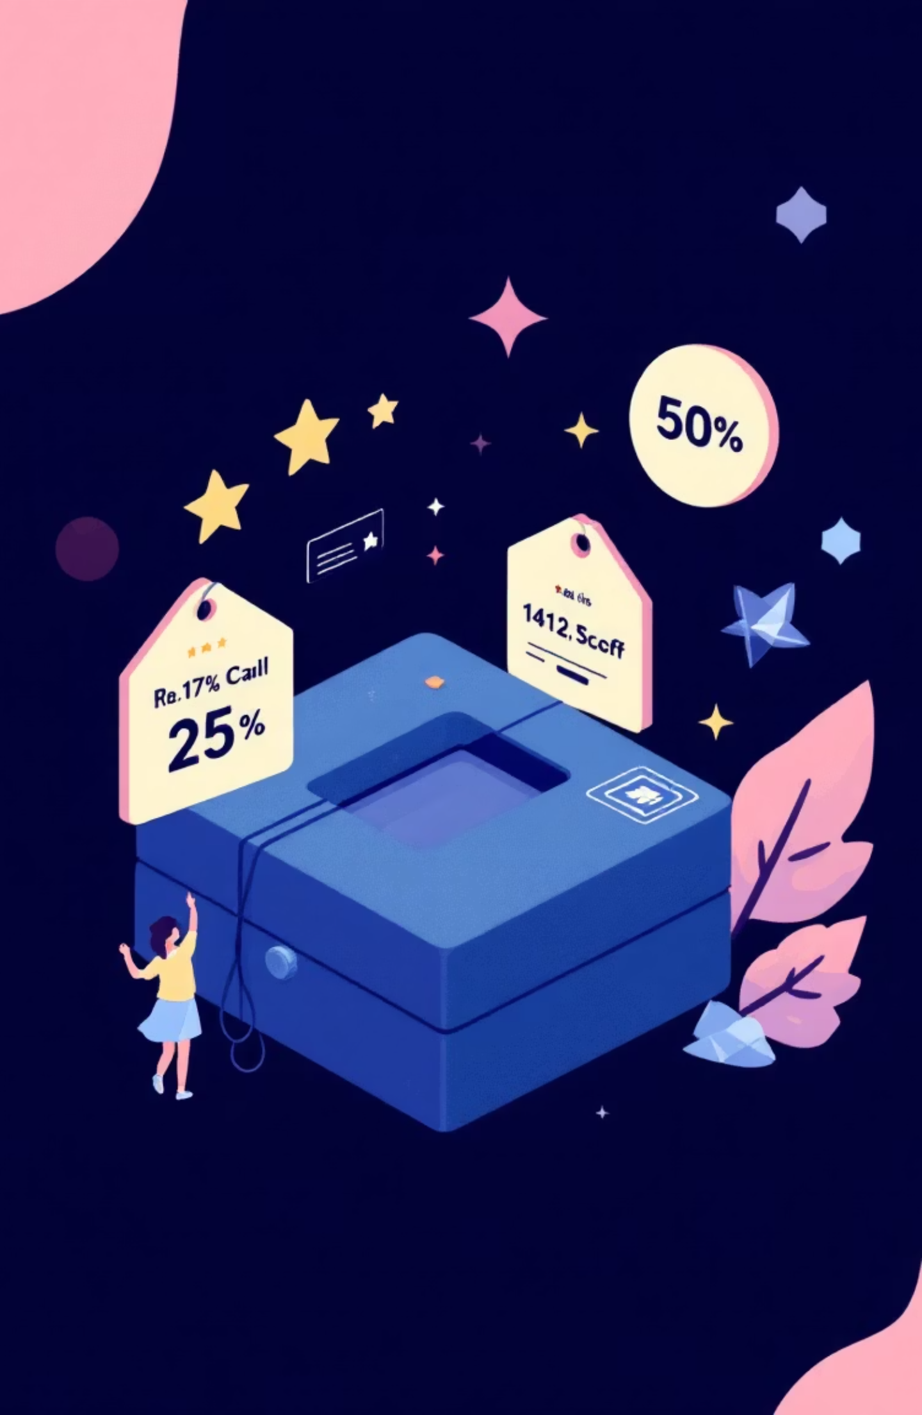
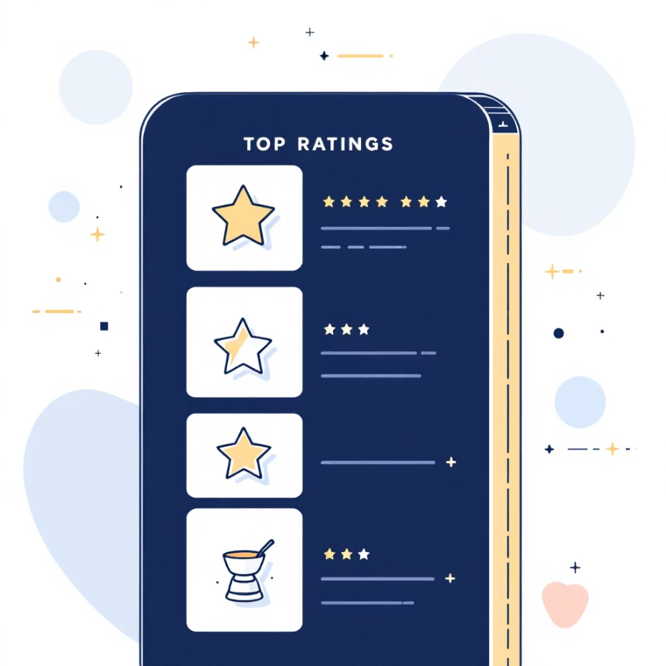
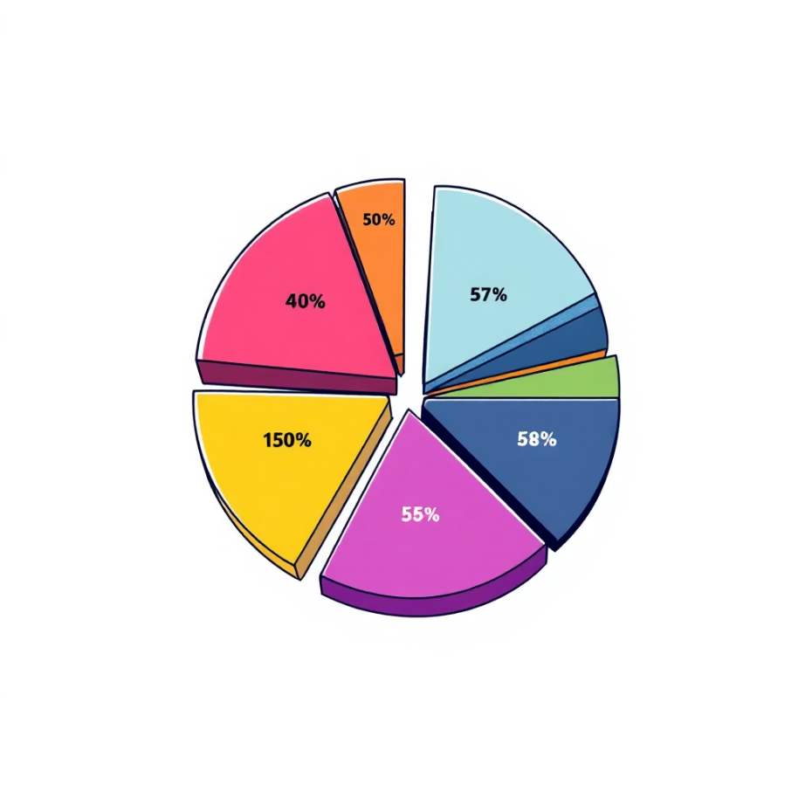
SQL Analysis: Product Performance
Top 5 Products by Review
Discounted Products
Highest average review ratings.
Top 5 products with highest discount percentage.

Slide 7

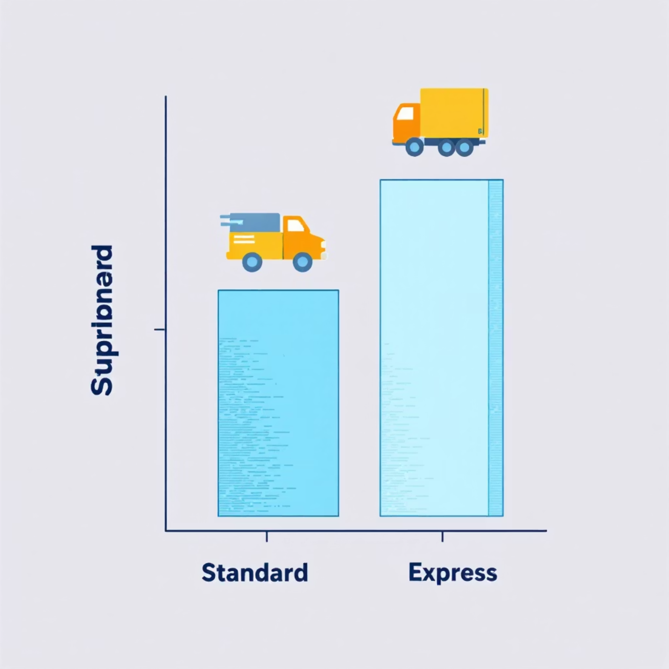
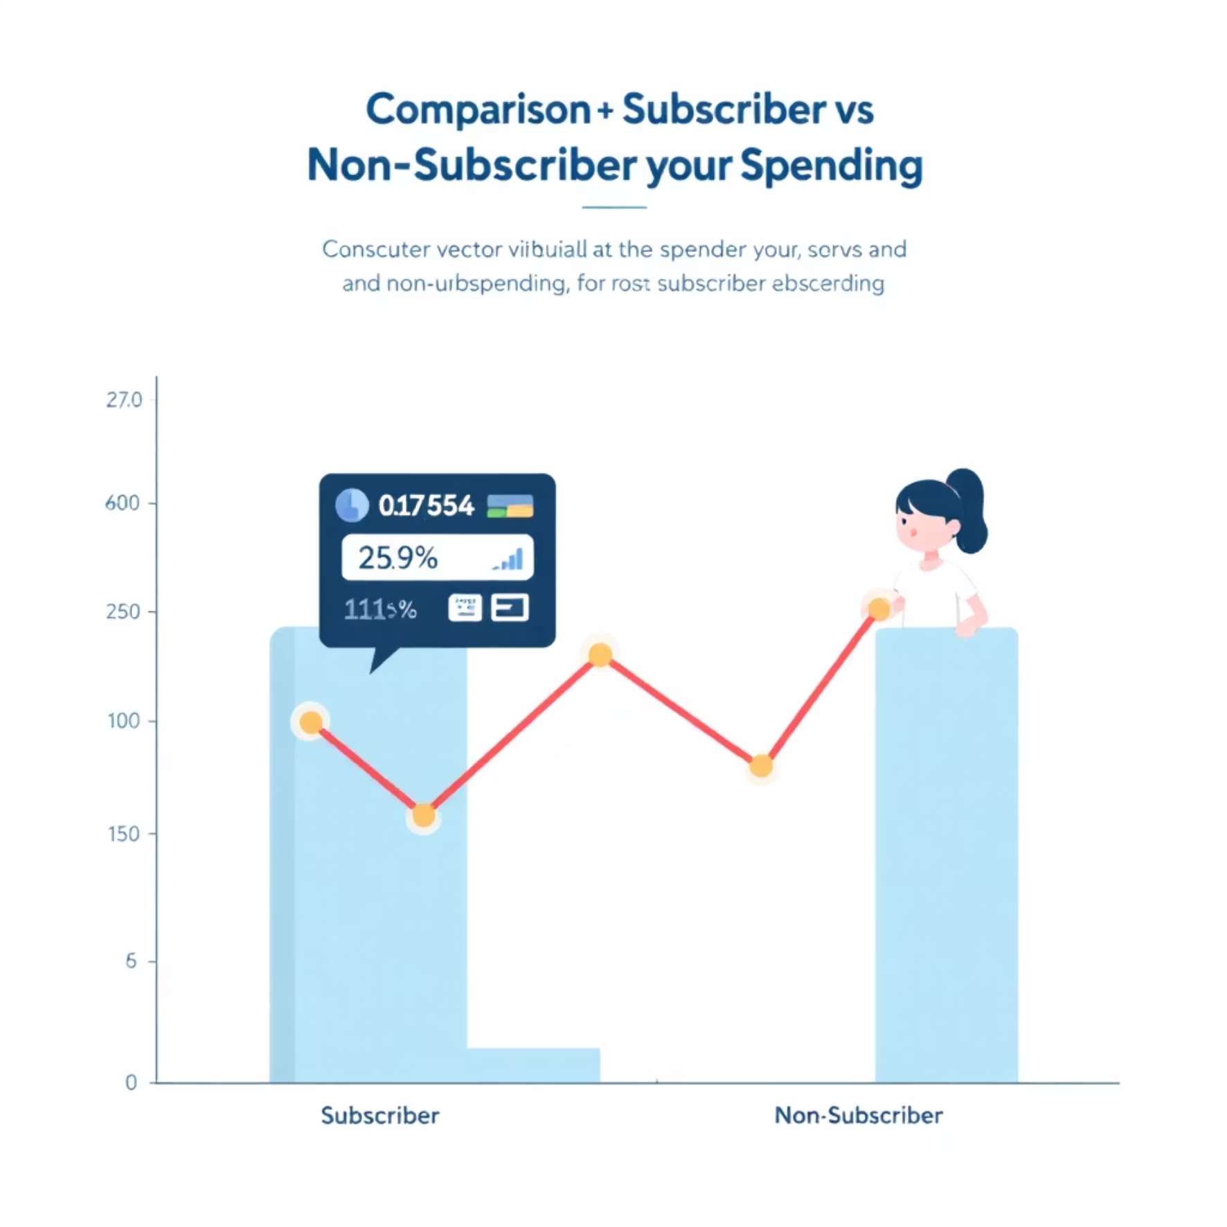
SQL Analysis: Shipping & Subscriptions
Shipping Comparison
Subscriber Spending
Average purchase amounts for Standard vs. Express Shipping.
Average spend and total revenue for subscribers vs. non-subscribers.

Slide 8
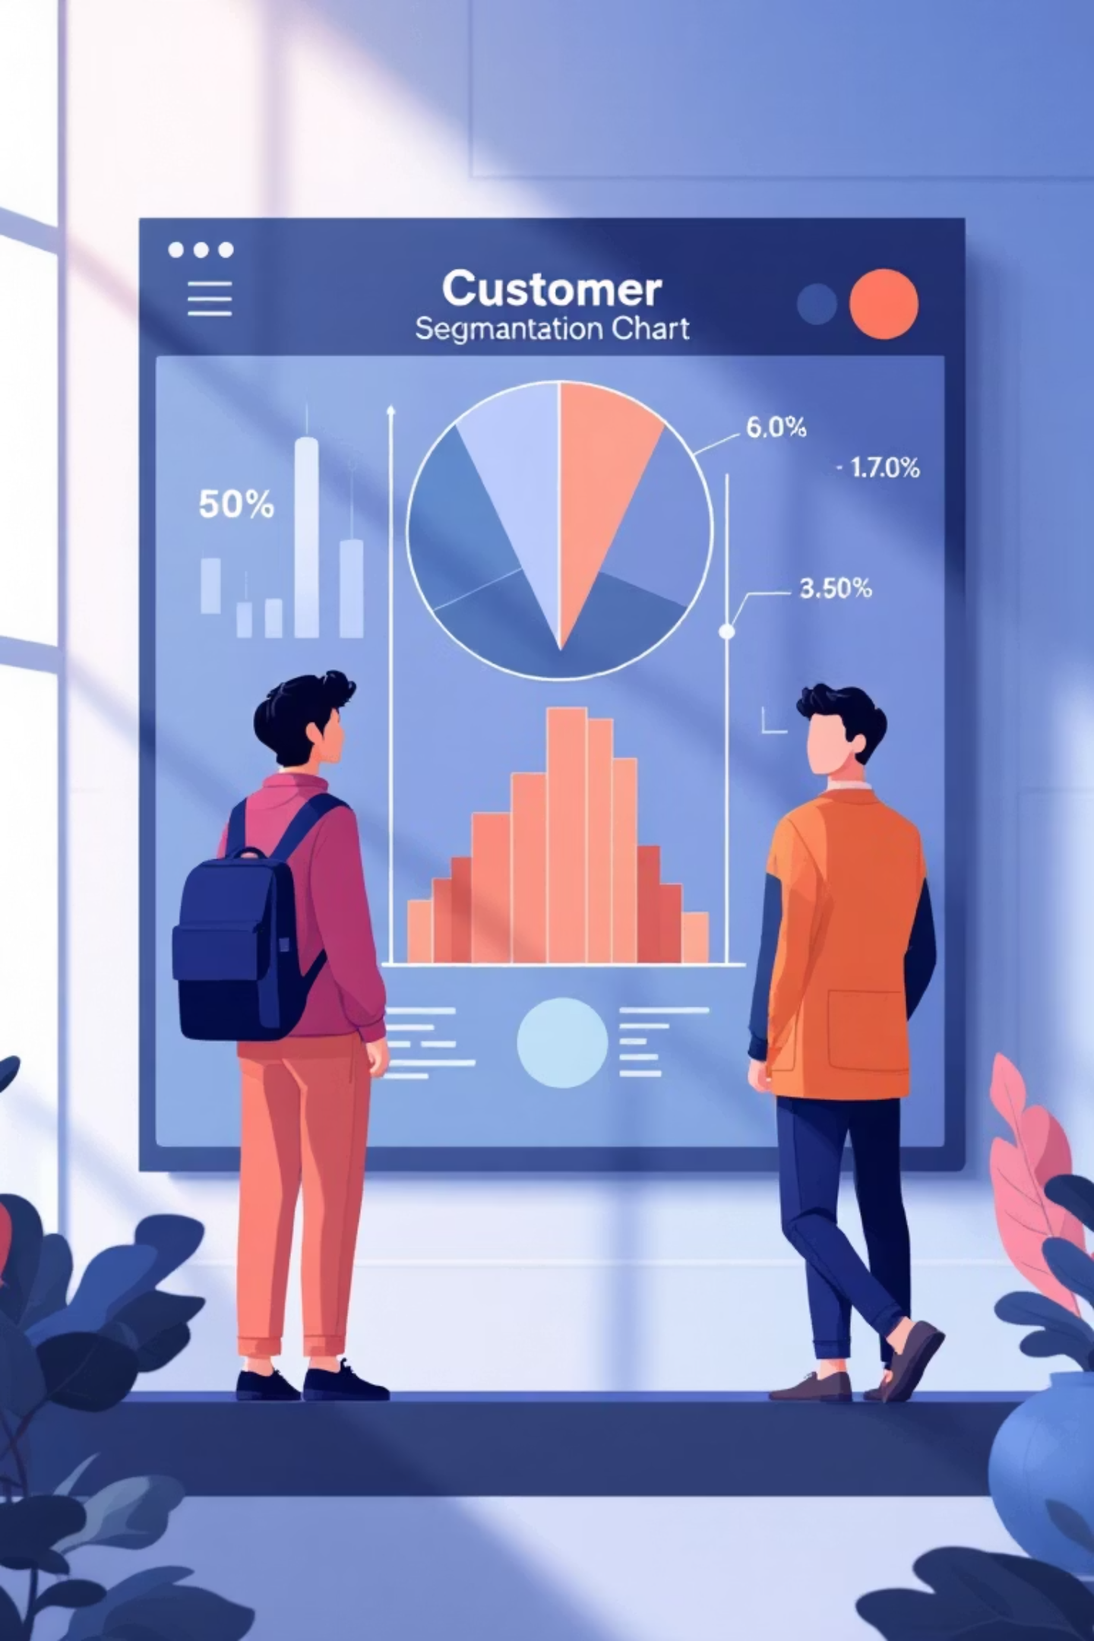
SQL Analysis: Customer Segmentation
1
2
New Customers
Returning Customers
First-time buyers.
Multiple purchases.
3
Loyal Customers
High previous purchases.
Count of each segment based on total previous purchases.

Slide 9

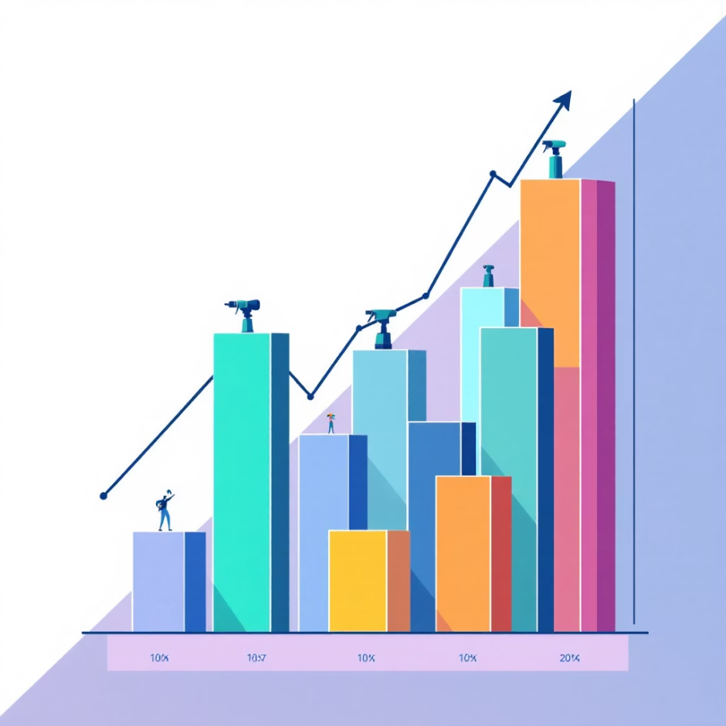
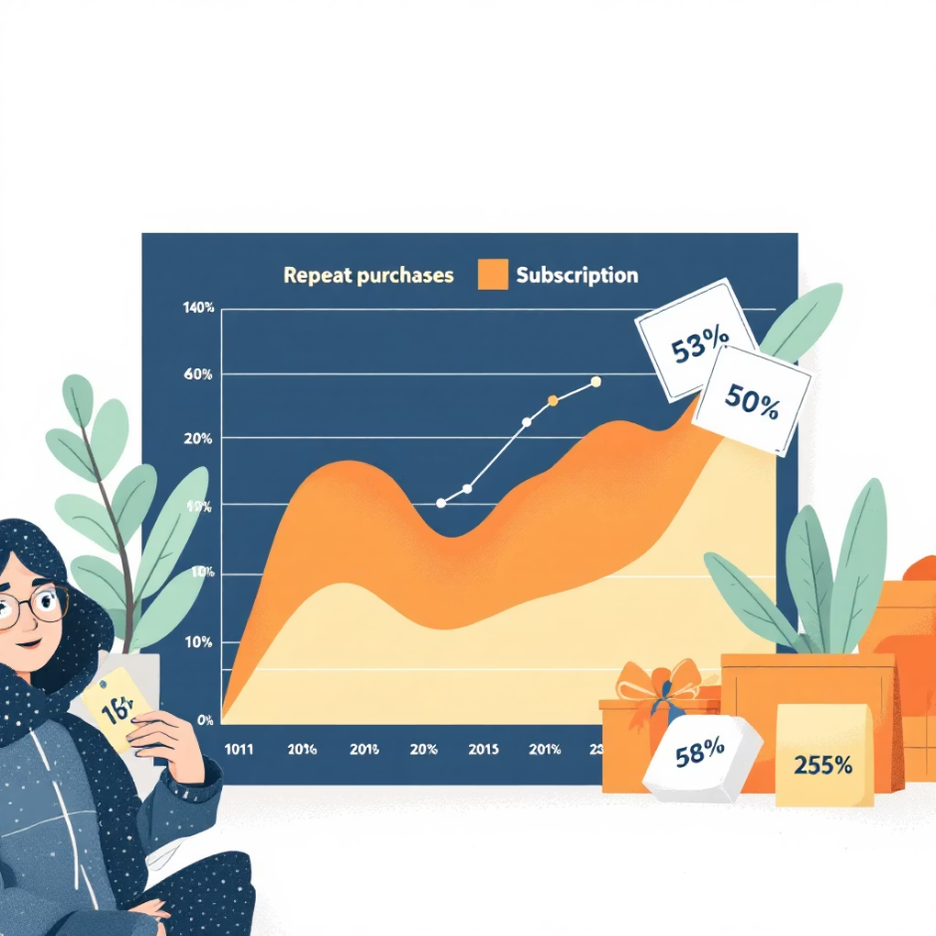
SQL Analysis: Product Categories & Loyalty
Top 3 Products per Category
Repeat Buyers & Subscriptions
Most purchased items within each product category.
Likelihood of repeat buyers (5+ purchases) to subscribe.

Slide 10

Business Recommendations
Increase Subscription Adoption
Promote exclusive offers and early access.
Strengthen Loyalty Programs
Reward points, cashback, tier-based benefits.
Optimize Discount Strategy
Ensure effective sales while maintaining profit.
Enhance Product Positioning
Prioritize top-rated products in marketing.
Targeted Marketing
Focus on high-revenue age groups and express shipping users.

